Slide 1
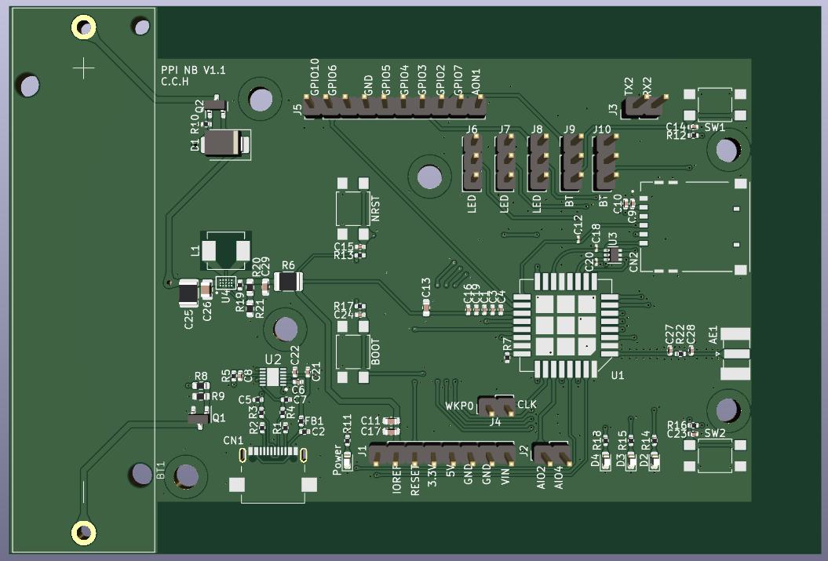
1. Conector J5
2. Conectores J6, J7, J8, J9, J10
3. Conector J3
1.bateria
3. botão SW1
1. botão NRST
1. Conector
SIM Card
2. botão Boot
1. Conector SMA
4. Conector J4
4. botão SW2
1. Conector CN1
USB tipo C
2. Led D4 Red
3. Led D3 White
1. Led Power Red
6. Conector J2
4. Led D2 Green
5. Conector J1

Slide 2
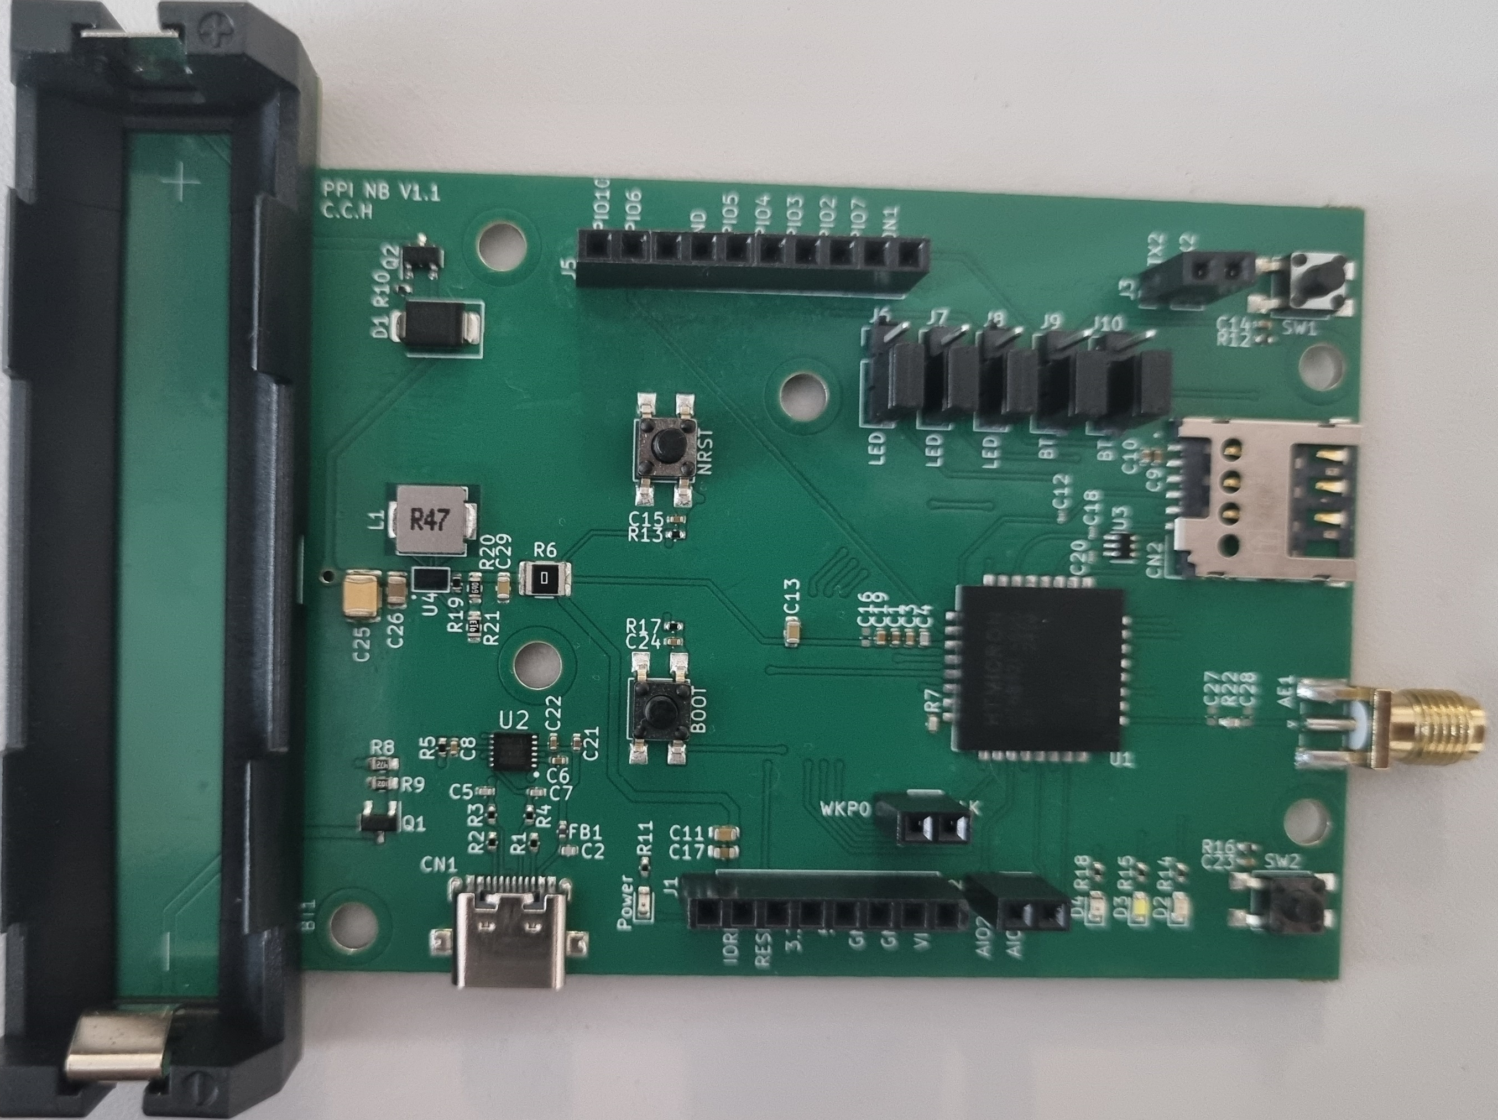
1. Conector J5
2. Conectores J6, J7, J8, J9, J10
3. Conector J3
1.bateria
3. botão SW1
1. botão NRST
1. Conector
SIM Card
2. botão Boot
1. Conector SMA
4. Conector J4
4. botão SW2
1. Conector CN1
USB tipo C
2. Led D4 Red
3. Led D3 White
1. Led Power Red
6. Conector J2
4. Led D2 Green
5. Conector J1

Slide 5
Short the Middle pin and the lower pin of J6, J7, J8, J9, J10 you can use the Led D4, D3, D2 and SW1 and SW2 button respectively.
Short the Middle pin and the Upper pin of J6, J7, J8, J9, J10 you can use the GPIO5, GPIO4, GPIO3, GPIO2 and GPIO7 pins respectively.

Slide 6
LED
J6
Use LED D4 (red)
LED
J6
Use GPIO5
LED
J7
Use LED D3 (white)
LED
J7
Use GPIO4
LED
J8
Use LED D2 (green)
LED
J8
Use GPIO3
BT
J9
Use botão SW1
BT
J9
Use GPIO2

Slide 7
BT
J10
Use botão SW2
BT
J10
Use GPIO7

